Slide 1
Chapter 11 Component-Level Design
Software Engineering: A Practitioner’s Approach, 6th edition
by Roger S. Pressman

Slide 2
What is Comp. Level Design?
A complete set of software components is defined during architectural design
But the internal data structures and processing details of each component are not represented at a level of abstraction that is close to code
Component-level design defines the data structures, algorithms, interface characteristics, and communication mechanisms allocated to each component
‹#›

Slide 3
What is a component?
“A modular, deployable, and replaceable part of a system that encapsulates implementation and exposes a set of interfaces.”
— OMG UML Specification
‹#›

Slide 4
Component Views
OO View – A component is a set of collaborating classes.
Conventional View – A component is a functional element of a program that incorporates processing logic, the internal data structures required to implement the processing logic, and an interface that enables the component to be invoked and data to be passed to it.
‹#›

Slide 5
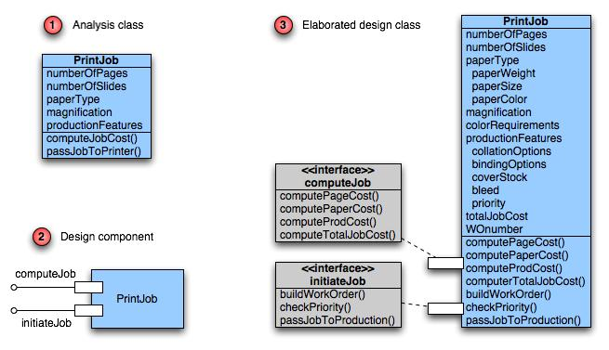
Class Elaboration
‹#›

Slide 6
Design Principles
Design by Contract
Open-Closed Principle
Subtype Substitution
Depend on Abstractions
Interface Segregation
‹#›

Slide 7
Design by Contract
The relationship between a class and its clients can be viewed as a formal agreement, expressing each party’s rights and obligations.
Consider the following list operation:
public Item remove(int index)
requires the specified index is in range ( 0 ≤ index < size( ) )
ensures the element at the specified position in this list is removed, subsequent elements are shifted to the left ( 1 is subtracted from their indices ), and the element that was removed is returned
‹#›

Slide 8
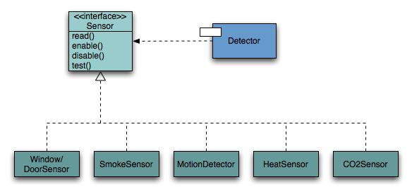
Open-Closed Principle
A module should be open for extension but closed for modification.
‹#›

Slide 9
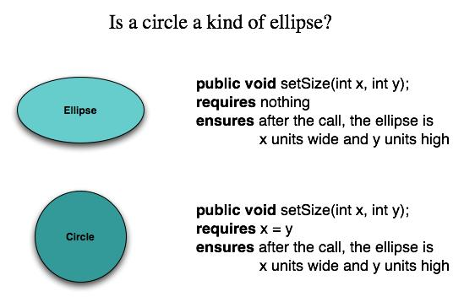
Substitutability
Subclasses should be substitutable for base classes
‹#›

Slide 10
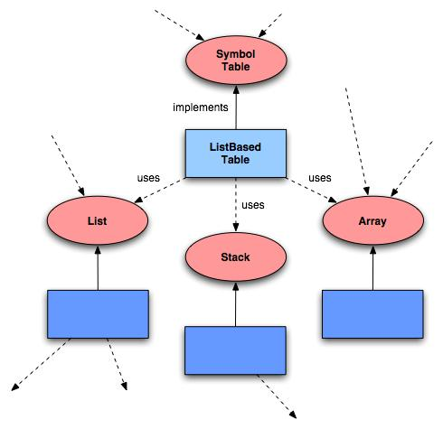
Dependency Inversion
Depend on abstractions. Do not depend on concretions.
‹#›

Slide 11
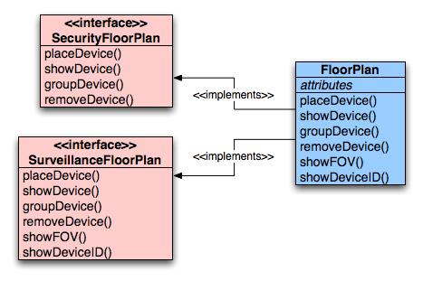
Interface Segregation
Many client-specific interfaces are better than one general purpose interface.
‹#›

Slide 12
Cohesion
The “single-mindedness” of a module
cohesion implies that a single component or class encapsulates only attributes and operations that are closely related to one another and to the class or component itself.
Examples of cohesion
Functional
Layer
Communicational
‹#›

Slide 13
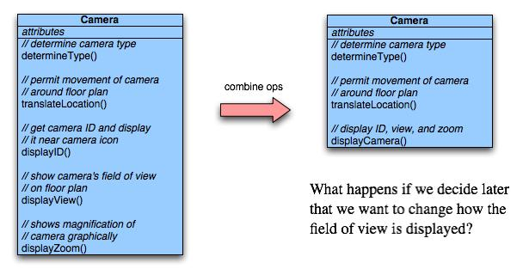
Functional Cohesion
Typically applies to operations. Occurs when a module performs one and only one computation and then returns a result.
‹#›

Slide 14
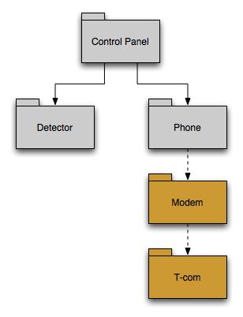
Layer Cohesion
Applies to packages, components, and classes. Occurs when a higher layer can access a lower layer, but lower layers do not access higher layers.
‹#›

Slide 15
Communicational Cohesion
All operations that access the same data are defined within one class.
In general, such classes focus solely on the data in question, accessing and storing it.
Example: A StudentRecord class that adds, removes, updates, and accesses various fields of a student record for client components.
‹#›

Slide 16
Coupling
A qualitative measure of the degree to which classes or components are connected to each other.
Avoid
Content coupling
Use caution
Common coupling
Be aware
Routine call coupling
Type use coupling
Inclusion or import coupling
‹#›

Slide 17
Content Coupling
Occurs when one component “surreptitiously modifies data that is internal to another component”
Violates information hiding
What’s wrong here? →
public class StudentRecord {
private String name;
private int[ ] quizScores;
public String getName() {
return name;
}
public int getQuizScore(int n) {
return quizScores[n];
}
public int[ ] getAllQuizScores() {
return quizScores;
}
….
‹#›

Slide 18
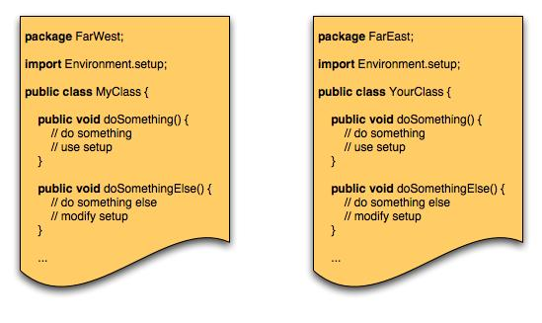
Common Coupling
Occurs when a number of components all make use of a global variable.
‹#›

Slide 19
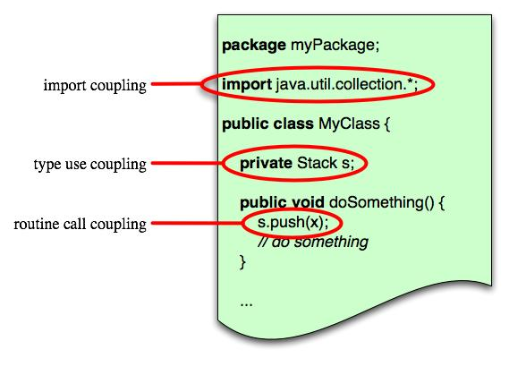
Routine Coupling
Certain types of coupling occur routinely in object-oriented programming.
‹#›

Slide 20
Component-Level Design
Identify design classes in problem domain
Identify infrastructure design classes
Elaborate design classes
Describe persistent data sources
Elaborate behavioral representations
Elaborate deployment diagrams
Refactor design and consider alternatives
‹#›

Slide 21
Steps 1 & 2 – Identify Classes
Most classes from the problem domain are analysis classes created as part of the analysis model
The infrastructure design classes are introduced as components during architectural design
‹#›

Slide 22
Step 3 – Class Elaboration
Specify message details when classes or components collaborate
Identify appropriate interfaces for each component
Elaborate attributes and define data structures required to implement them
Describe processing flow within each operation in detail
‹#›

Slide 23
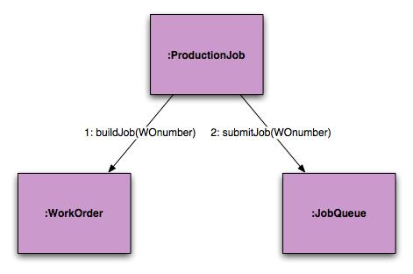
3a. Collaboration Details
Messages can be elaborated by expanding their syntax in the following manner:
[guard condition] sequence expression (return value) :=
message name (argument list)
‹#›

Slide 24
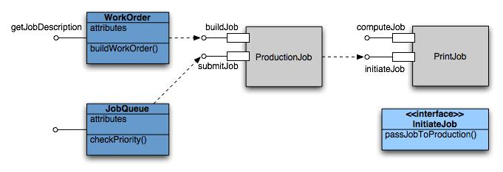
3b. Appropriate Interfaces
Pressman argues that the PrintJob interface “initiateJob” in slide 5 does not exhibit sufficient cohesion because it performs three different subfunctions. He suggests this refactoring.
‹#›

Slide 25
3c. Elaborate Attributes
Analysis classes will typically only list names of general attributes (ex. paperType).
List all attributes during component design.
UML syntax:
name : type-expression = initial-value { property string }
For example, paperType can be broken into weight, size, and color. The weight attribute would be:
paperType-weight: string =
“A” { contains 1 of 4 values – A, B, C, or D }
‹#›

Slide 26
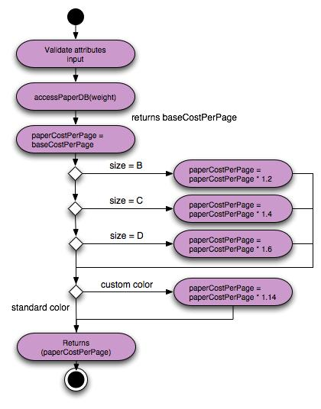
3d. Describe Processing Flow
Activity diagram for computePaperCost( )
‹#›

Slide 27

Step 4 – Persistent Data
Describe persistent data sources (databases and files) and identify the classes required to manage them.
‹#›

Slide 28
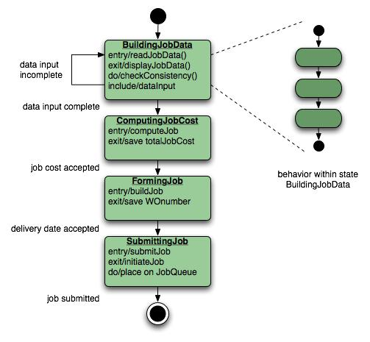
Step 5 – Elaborate Behavior
It is sometimes necessary to model the behavior of a design class.
Transitions from state to state have the form:
Event-name (parameter-list) [guard-condition] / action expression
‹#›

Slide 29
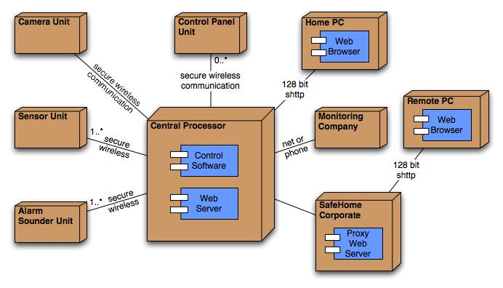
Step 6 – Elab. Deployment
Deployment diagrams are elaborated to represent the location of key packages or components.
‹#›

Slide 30
Step 7 – Redesign/Reconsider
The first component-level model you create will not be as complete, consistent, or accurate as the n^{th} iteration you apply to the model.
The best designers will consider many alternative design solutions before settling on the final design model.
‹#›

